Slide 1



GITA, Bhubaneswar
Date : April 23rd, 2018
Smart Garbage Bin and Waste Management

Slide 2
INTRODUCTION
Today main issue for pollution is Garbage Overflow. It creates unhygienic condition for the people and creates bad smell around the surroundings this leads in spreading some deadly diseases & human illness. To avoid all such situations we are going to implement a project called IoT Based waste management using smart dustbin.
Smart Garbage Bin and Waste Management

Slide 3

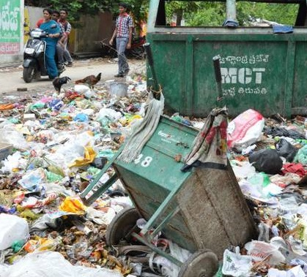
1.Dumping of garbage from
different sources.
2. India generates 1,00,000 metric
tons wastes everyday.
3.Whole India (including rural and
urban areas) has the problem.
4.Human being as well as animals
are facing a lot of problems due
to the illegal dumping of garbage.
5.People are killing their own
present as well as future
generations
Picture source: The Hindu
Information source: Times of India
Smart Garbage Bin and Waste Management

Slide 4
SOLUTIONS
Implementation is done with the help of IoT concept. The Internet of Things (IoT) is a concept in which surrounding objects are connected through wired and wireless networks without user intervention. Objects communicate and exchange information. In this system multiple dustbins are located throughout the city or the Campus, these dustbins are provided with a sensor which helps in tracking the level and weight of the garbage bins and a unique ID will be provided for every dustbin in the city so that it is easy to identify which garbage bin is full. When the level and weight of the bin reaches the threshold limit, the device will transmit the reading along with the unique ID provided. In order to avoid the decaying smell around the bin harm-less chemical sprinkler is used which will sprinkle the chemical as soon as the smell sensors detect the decaying smell.
Smart Garbage Bin and Waste Management

Slide 5
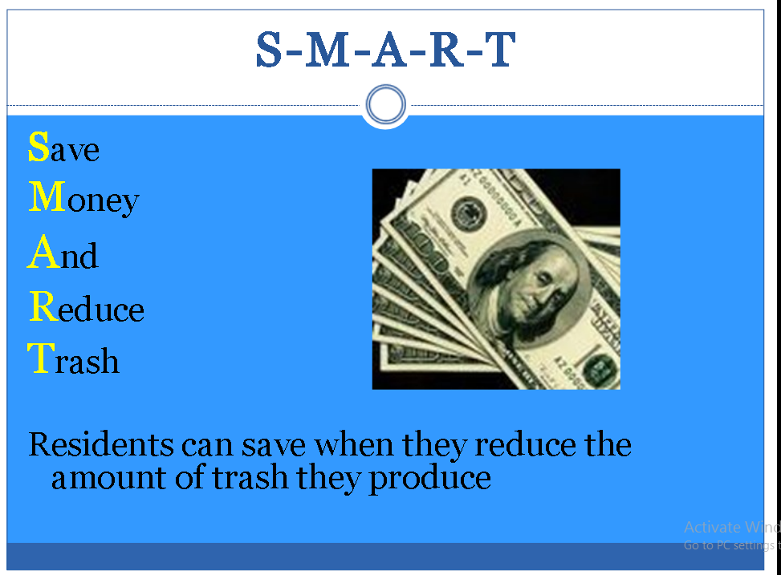
Smart Garbage Bin and Waste Management

Slide 6

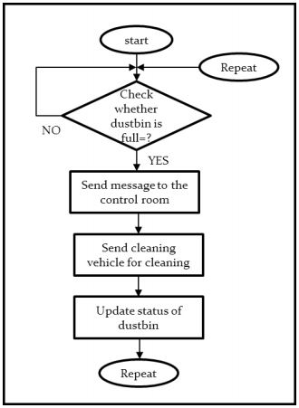
This product can handle all the task of dustbin smartly and automatically. Some of the key features of our product are:
Automatic opening of dustbin when it receives signal.
A level sensing ultrasonic sensor that constantly measure the level of garbage in the bin.
Vast usage in offices, home, public places for garbage management system.
Smart Garbage Bin and Waste Management

Slide 7
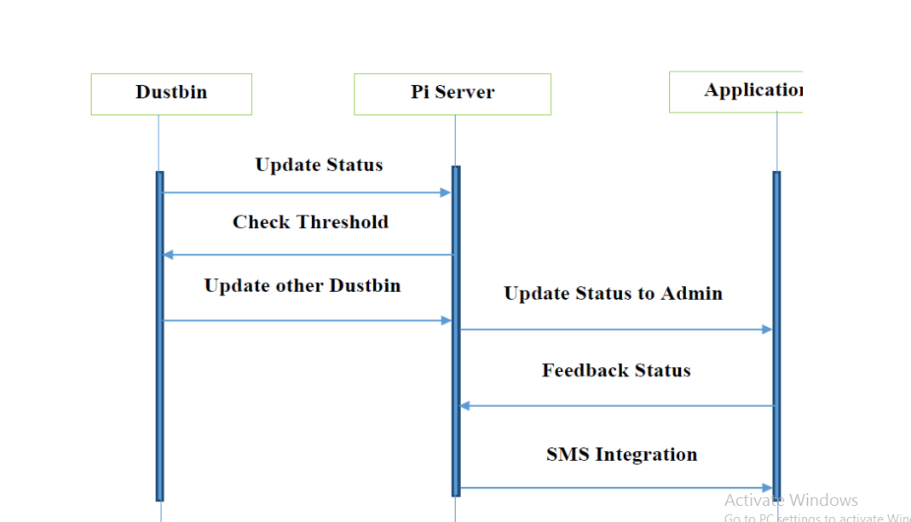
Smart Garbage Bin and Waste Management

Slide 8
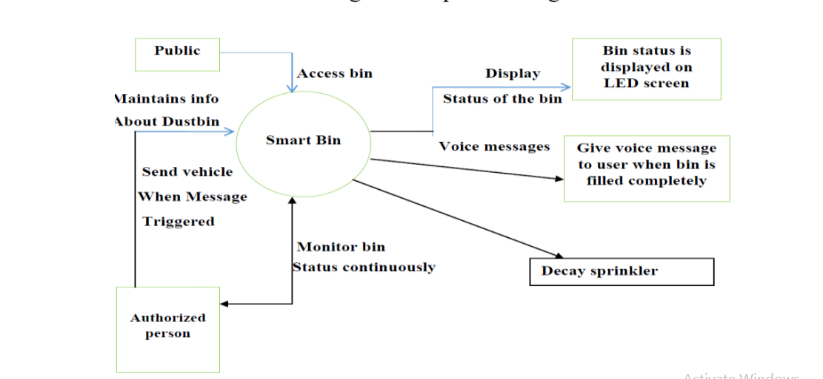
Smart Garbage Bin and Waste Management

Slide 9
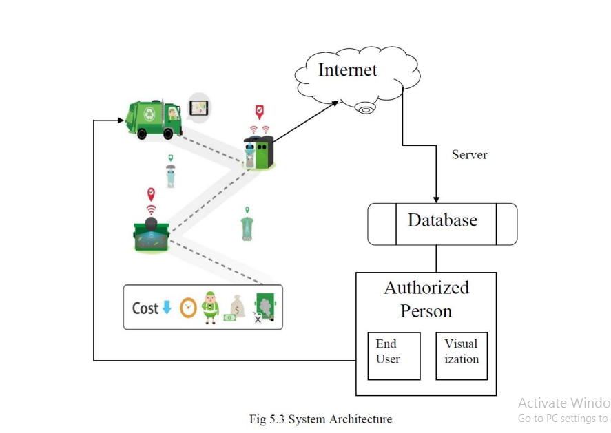
Smart Garbage Bin and Waste Management

Slide 10

Here in the smart dustbin contains
motor-driver
16*2 LCD Display
Aurdino UNO
Load cell
Playback IC
Speaker
IR Sensors & Smell Sensors
Bread Board
Power Supply and Raspberry pi.
Smart Garbage Bin and Waste Management

Slide 11
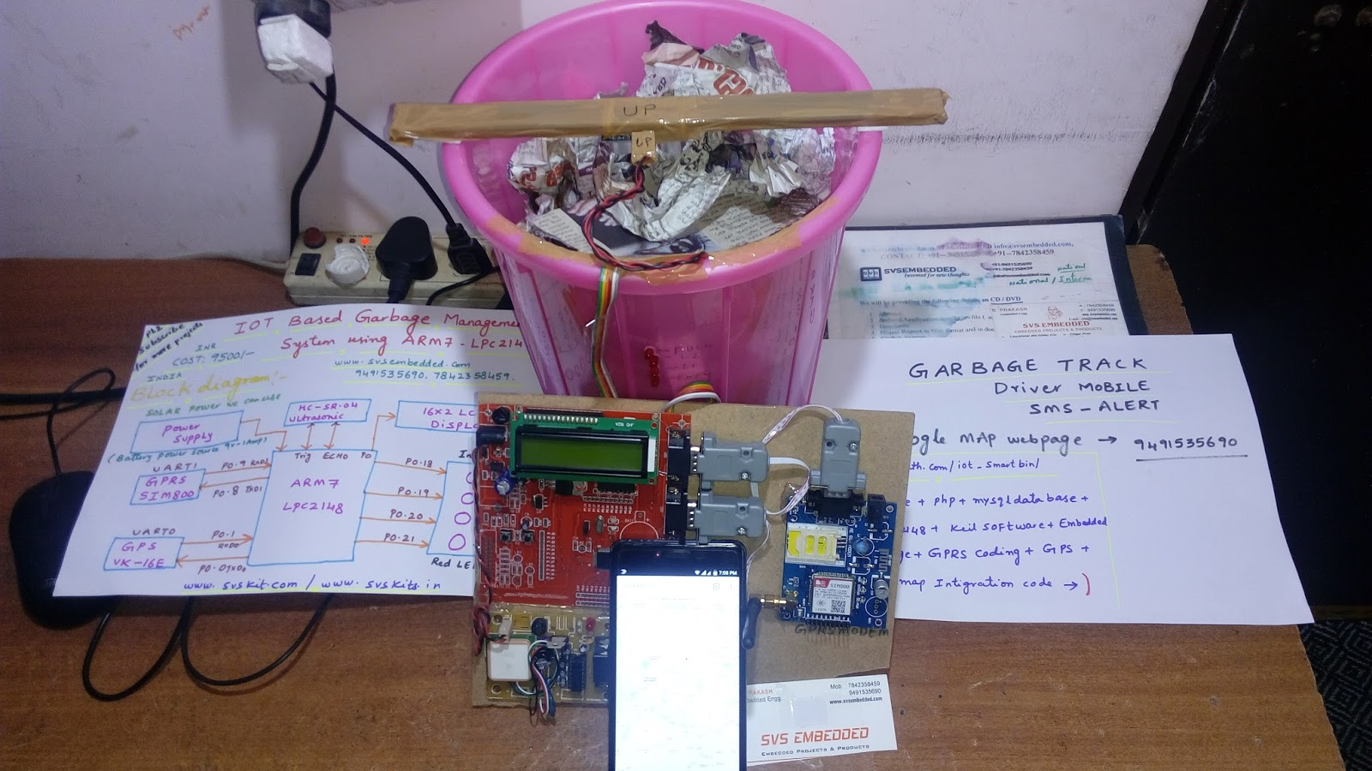
Smart Garbage Bin and Waste Management

Slide 12

Measure the state of dustbin remotely.
Efficient management of the smart dustbins.
Remote monitoring of the dustbins and controlling using microcontroller and GSM module.
Smart Garbage Bin and Waste Management

Slide 13

The whole country is suffering from the problem of garbage and waste. Specially the household waste are being dumped everyday inside the cities and urban areas. But the municipality is not even bothered to take care of the overflowing dustbins inside the wards.
Our first target would be:
The municipal areas around the cities so that the implementation can make a difference.
Next, the same technology will be expanded in other municipal wards. And since this problem is a serious issue, the people will accept this technology to quench their thirst against the garbage.
Smart Garbage Bin and Waste Management

Slide 14

Since this technology is very cheap, the marketing is expected to grow exponentially. Our steps would be:
Directly visiting municipal offices and show the advantages of using this technology for efficient waste management.
Distribution of leaflets among people to encourage them to use the smart dustbin technology.
As of now, the government is giving their efforts like Swachha Bharat Abhiyaan, so it’s a great option for us to standardize this product.
Smart Garbage Bin and Waste Management

Slide 15

Though this project is based on social impact, we are having a revenue model for the project:
Installation of the product all over the city.
Sales and marketing to private stakeholders.
Maintenance and operational revenue.
Miscellaneous Cost(Electricity bill, etc.)
Smart Garbage Bin and Waste Management

Slide 16

These companies are also implementing the same model:
BioEnable Technologies Pvt. Ltd.
ECube Labs
We are unique because:
The unit cost is less as compared to other companies.
The installation cost and maintenance cost are quite less.
We will take care of the outcomes of the seasonal changes like rainy seasons.
The NRE cost is low.
Smart Garbage Bin and Waste Management

Slide 17

Type | Unit Cost (in Lakh)
Technology fee: | 1.00
Telephone/FAX/ Computer Facility | 0.25
Machine hiring | 0.80
Guidance fee for mentors | 2.50
Electricity / Accommodation charges | 0.75
Installation and Maintenance Cost | 0.80
Total Cost | 6.1
Smart Garbage Bin and Waste Management

Slide 18

Current Status :
Research over the idea and the problems related to the waste and garbage.
Duration Required :
8 to 10 months
Smart Garbage Bin and Waste Management

Slide 19
RESULT & CONCLUSION
This implementation of smart garbage Bin indicator receptacle, gives a solution for unsanitary environmental condition in a city. This implementation of Smart Garbage collection bin using internet, IR sensor, and raspberry pi. This system assures to send mail notification and status on dashboard of dustbins when the garbage level reaches its maximum. If the dustbin is not cleaned in specific time, then the record is sent to the higher authority who can take appropriate action against the concerned contractor.
This system also helps to monitor the fake reports and hence can reduce the corruption in the overall management system. This reduces the total number of trips of garbage collection vehicle and hence reduces the overall expenditure associated with the garbage collection. It ultimate helps to keep cleanness in the society. Therefore, the smart garbage management system makes the garbage collection more efficient the use of solar panels in such systems may reduce the energy consumption. Such systems are vulnerable to plundering of components in the system in different ways which needs to be worked on. These dust bin model can be applied to any of the smart cities around the world. A waste collecting and monitoring team which is deployed for collection of garbage from the city can be guided in a well manner for collection.
Smart Garbage Bin and Waste Management

